Slide 1
PAL WEEK
Learning Sustainable Development in Design & Engineering
Dr Nigel P. Garland
Dr Zulfiqar A. Khan
Sustainable Design Research Centre
Faculty of Science and Technology

Slide 2
Sustainability: WHAT?
“..a process of change in which the exploitation of resources, the direction of investments, the orientation of technological development; and institutional change are all in harmony and enhance both current and future potential to meet human needs and aspirations.”
Bruntland Report or
“Our Common Future” World Commission on Environment and Development
Notes:
Bruntland Report or “Our Common Future” World Commission on Environment and Development.
What does this mean?
How do you plan for the present?
It is normally shown omitting the second half of the definition....

Slide 3
SD Primers: WHAT?
Full week of project work
First teaching week of year
No other teaching
1st and 2nd year DE & DBM students
PAL and PBL methods
Underlying theme
Sustainable Development
Informed
Developed from international best practice
Meets ECUK SPEC and RAE guidance
Notes:
Essentially, we have a captive audience with fresh clean minds.

Slide 4
SD Primers: Structure
Fluid
Adaptive for each stage outcome
Activity
Regular randomized presentations
Always with Q/A and reflection
Brief expanded after each
Little or no didactic element
Assessment
Final formal presentation marked
Peer assessment within each group
Notes:
Consideration of wider issues and cultures outside of their normal life
Commitment to course and the work ethic required

Slide 5
SD Primers: Implementation 2009
Mosquito net for Niger Delta
For local manufacture
Barriers to market
Function and use
Outcomes
Cultural barriers
Clear social benefit outweighs ecological concern
Physical prototypes
Notes:
Barriers:
Don’t believe malaria is from mosquitoes: fatty food, too long in the sun!
Single room housing: 1 goes to bed, all go to bed!
The challenge to overcome barriers is a reflection of the barriers to sustainability, they are challenging existing cultural norms!

Slide 6
SD Primers: Implementation 2010 & 2012
Design of consumer products
Groups each examined a different product
Technical description
Function and use, social benefit
Outcomes
Aspirational or Inspirational?
Effective utilisation of materials
Alternative routes to deliver same benefits
Notes:
Products: Supplied with physical artefacts
Technical: If you want to know think outside of the box, you’ve got to know what’s in the box!
Function and benefit: To the individual as well as wider impact upon society.
Is their real social value? Is it genuinely useful or just a gadget for showing off? How can this be increased? Specific market segmentation.
Are the products a waste of the earths natural resources? Are materials tied up in non-use phase! How can this be improved.
How can alternative routes to market or other services deliver similar goals?

Slide 7
SD Primers: Implementation 2011 & 2013
Sustainable energy products?
Groups each examined different “solutions”
Technical description
Viability
Outcomes
Impact of Scale upon the supply chain
Effective utilisation of materials
Vision (2013)
Notes:
Technical: If you want to think outside of the box, you’ve got to know what’s in the box!
Viability: is the supply chain able to support if scaled up. REE’s etc.
Limitations of the Environment to support the technologies….
Are the products a waste of the earths natural resources? Are materials tied up in non-use phase! How can this be improved.
How can alternative routes to market or other services deliver similar goals?

Slide 8
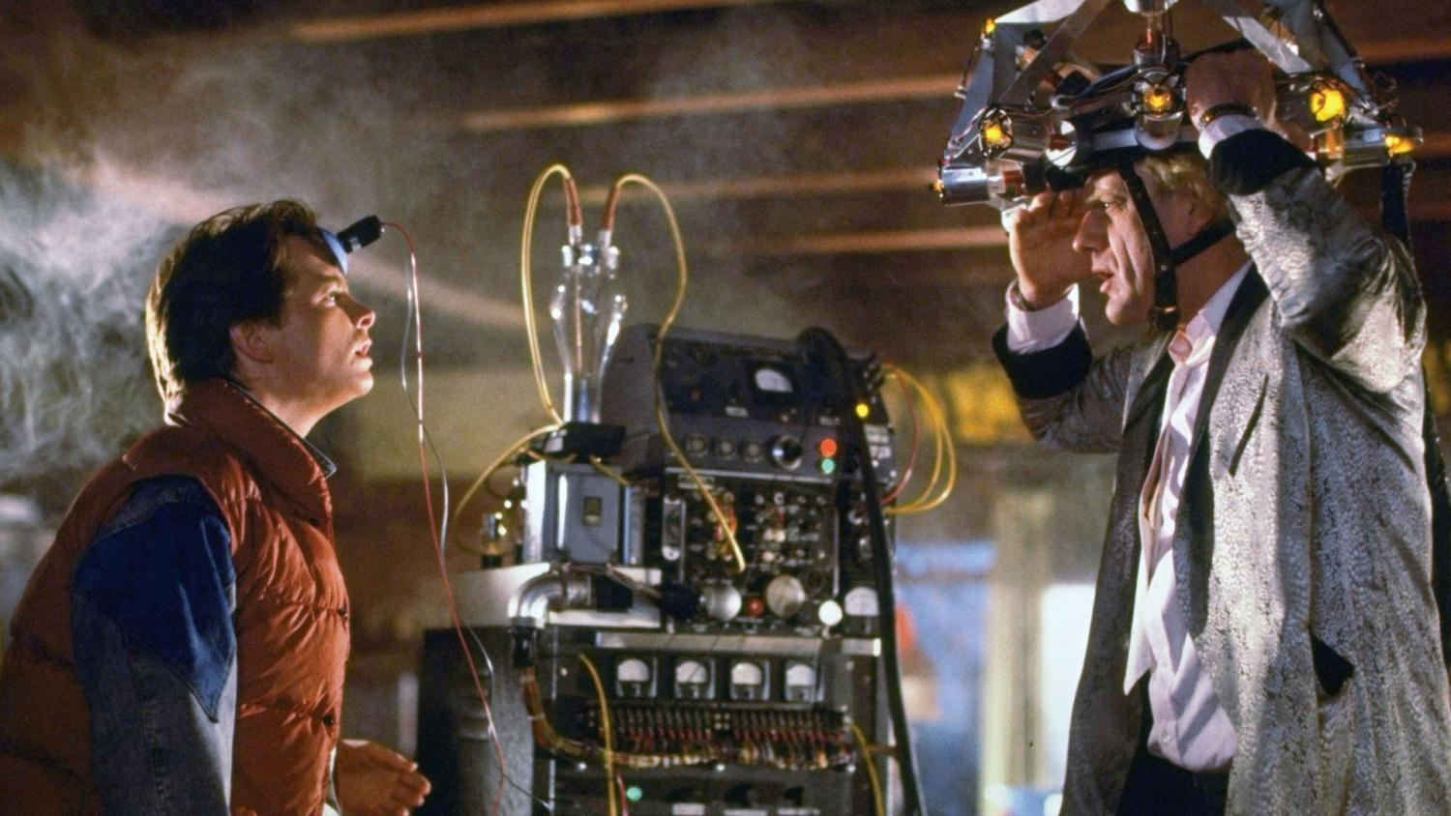
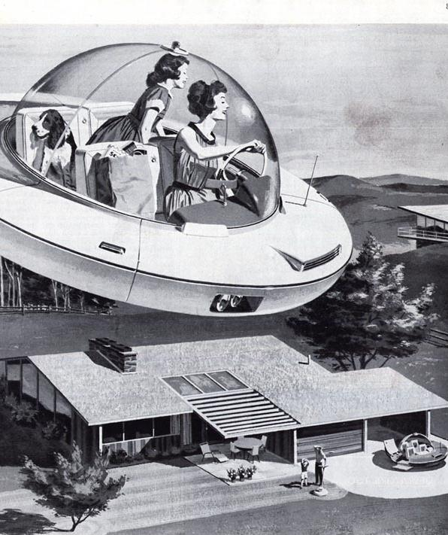
Sustainability: Vision
What will the future look like?
How will resource scarcity affect the economy?
What effect emerging economies?

Slide 9
Academic: Outcomes
Needs?
Transition from teaching to learning
Student engagement from day zero
Broader conceptual understanding
knowledge?
New concepts & methodologies tested & developed
Expectations?
Student expectations set in first week
Level of commitment clear
Notes:
Life long learning skills
Engagement frames the next four years
Consideration of wider issues and cultures outside of their normal sphere
How all the little things in the course all come together
Commitment to course and the work ethic required

Slide 10
Research: Outcomes
New conceptual models
Social Usefulness
Is it socially useful?
Or, is it a waste of the Earth’s natural resources?
In other words, does it make a positive contribution to society and does that contribution outweigh the economic, environmental and human costs?

Slide 11
Research: Outcomes
New conceptual models
Social Usefulness
Material Utilisation
Where:
U_{R} is the utilization of resources,
P_{P} is the product population,
R is the resources embodied,
L_{t} is the technological life,
L_{p} is the life of the product and
U_{p} is the usage pattern of the product.
Notes:
Material utilisation examines how much “stuff” is tied up doing nothing.

Slide 12
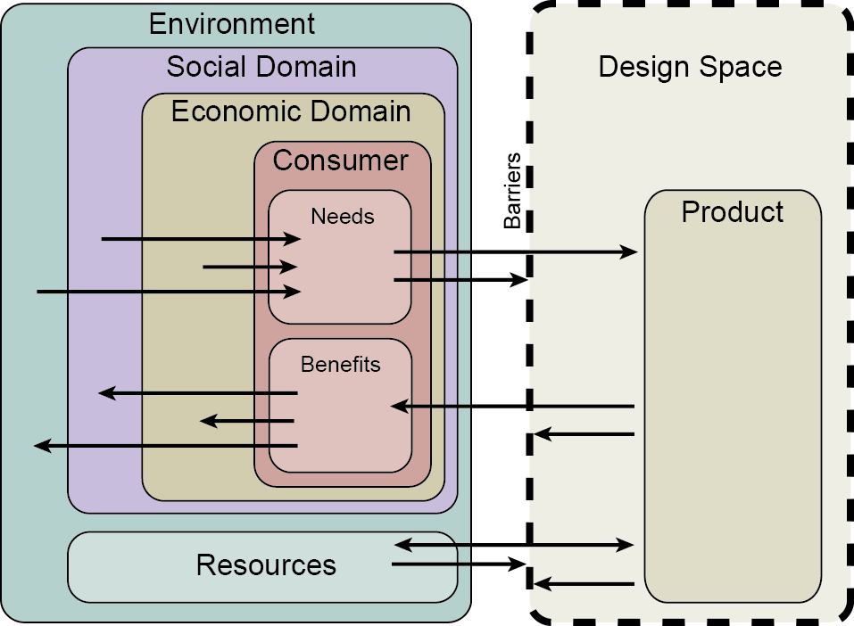
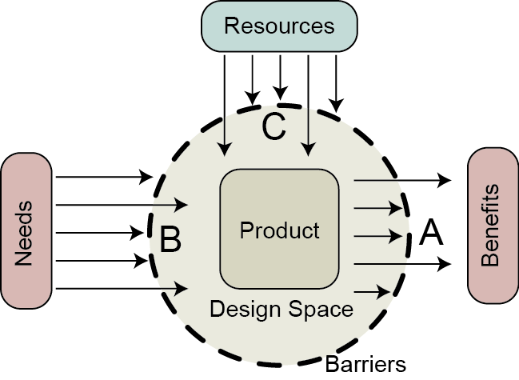
Research: Outcomes
New conceptual models
Social Usefulness
Material Utilisation
Barriers to Sustainable Product Engineering
De-Primarkisation
Published
Sustainability
EPDE 2010, 11, 12
Where A is cultural values and tradition; B is product perception; C is scale and viability
Notes:
We examine needs, apply resources, deliver benefits:
Barrier A was the mosquito net project; B was the consumer products; C was the sustainable energy.
De-primarkisation looks at how diminishing resources will transform society away from low cost throw away to high value durables.

Slide 13
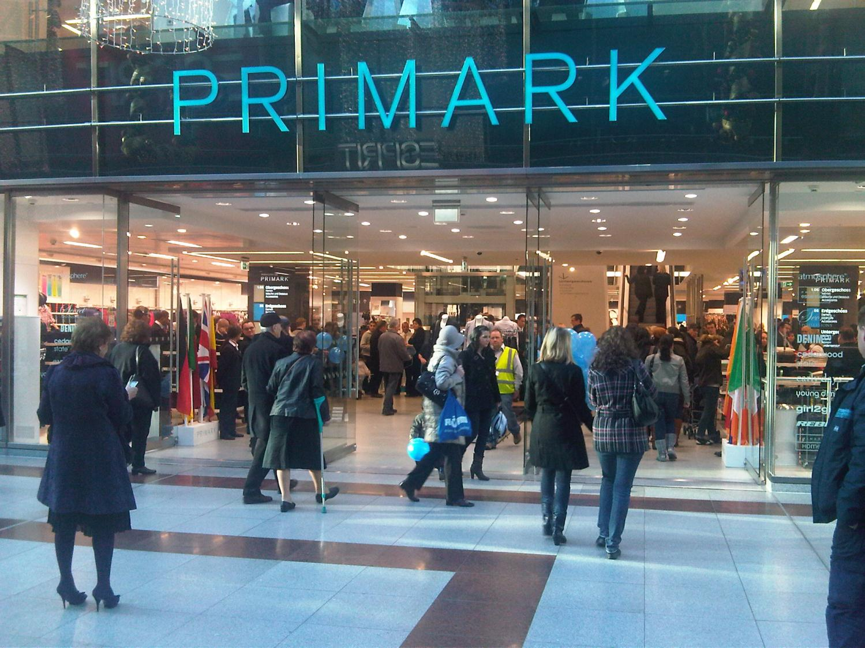
DE-PRIMARK-ISATION
Resource scarcity is inevitable
Low materials costs
high consumption, low quality, short life
More purchased, low value, impulse buy, duplication, may never be used…...low margin!
High materials costs
low consumption, higher quality, longer life
Fewer bought, high value, considered purchase, bought to be used……high margin!
Cost of functional output may be the same

Slide 14
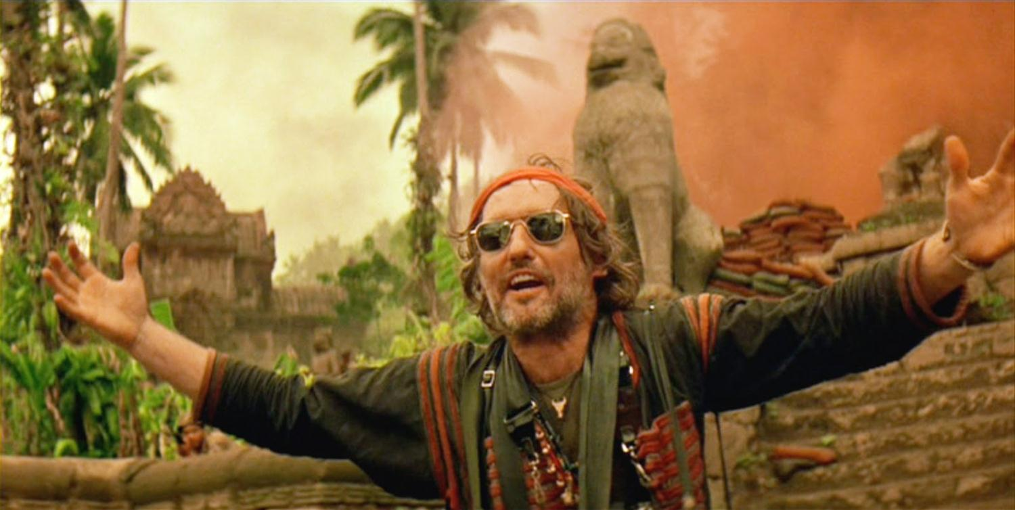
Key Point

